Slide 1

Reinforcement Learning For Sports Analytics
Oliver Schulte
School of Computing Science
Simon Fraser University
Vancouver, Canada
Notes:
If you use “insert slide number” under “Footer”, that text box only displays the slide number, not the total number of slides. So I use a new textbox for the slide number in the master.
This is a version of “Equity”.

Slide 2
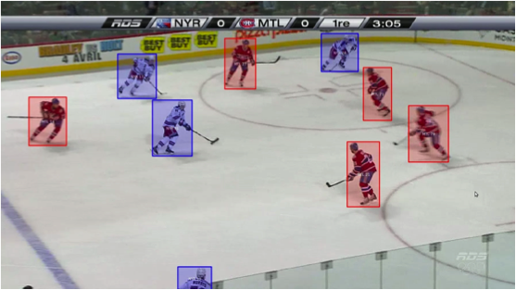
Sports Analytics and Reinforcement Learning
Sports represents many issues in complex multi-agent scenarios
competition
cooperation
contribution of individual to group outcomes
Q = 0.2
Fundamental Question: What contributes to winning?
Can be answered by learning a value function Q(s,a) = expected reward given match state s and action a
Reward = win/goal
RL is used to evaluate the behaviour of real human agents
Notes:
Fit in picture of matching match state to value
not to control the behaviour of artificial agents.

Slide 3
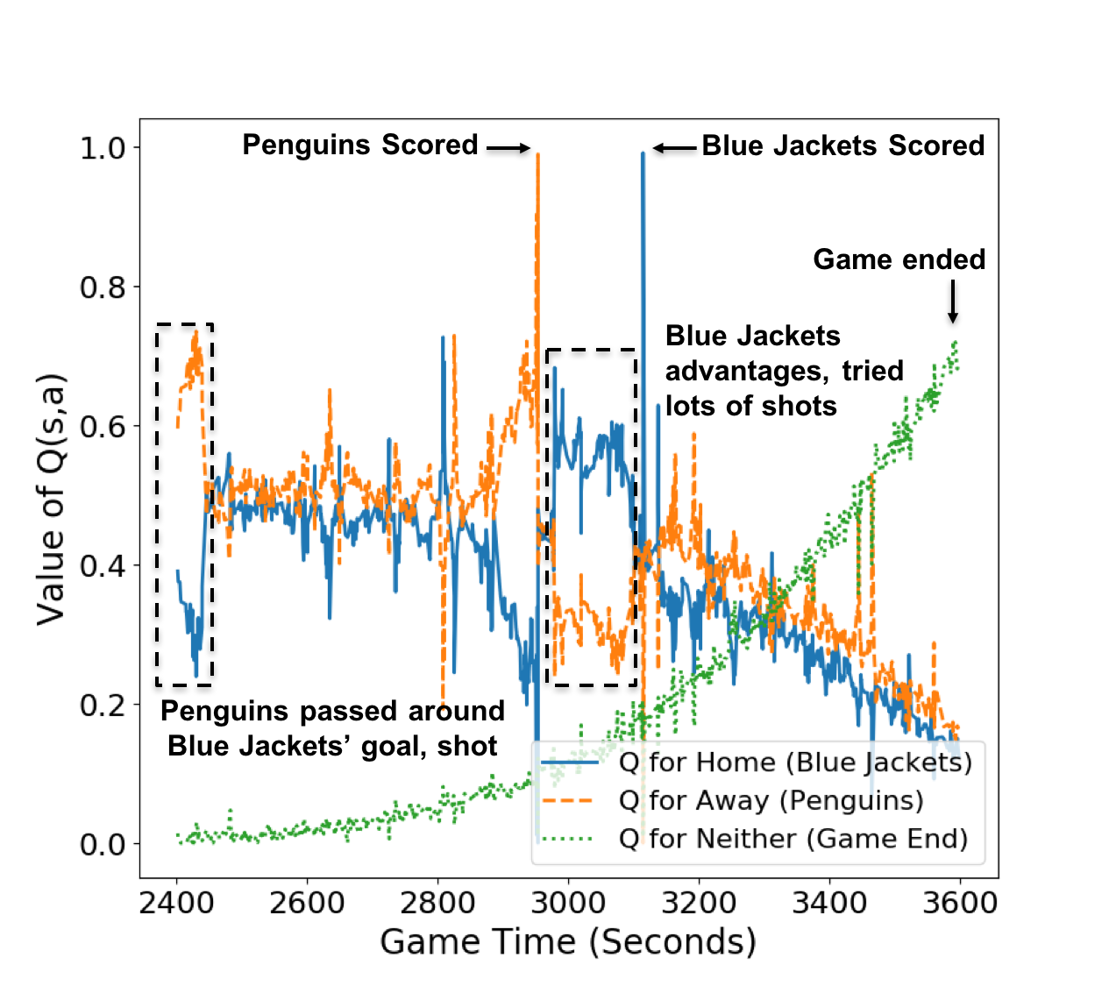
Value Ticker and Action Impact
Value Q function represented by LSTM
Learned on NHL dataset from SportlogiQ
2015-2016, > 3M events
Q = chance of scoring the next goal
Blue Jackets vs. Penguins Nov 17, 2015
Notes:
Sportlogiq has more than half the NHL teams
University of Michigan researchers on NBA doubling (putting 2 players on one opponent)

Slide 4
Application: Player Ranking
Action Goal Impact = Change in Goal Scoring Chance
Player Goal Impact Metric:= add up goal impact of player’s actions
Name | GIM | Goals | Points | Team | Salary
Taylor Hall | 96.40 | 26 | 65 | EDM | $6M
Joe Pavelski | 94.56 | 38 | 78 | SJS | $6M
Johnny Gaudreau | 94.51 | 30 | 78 | CGY | $9.25K
Anze Kopitar | 94.10 | 25 | 74 | LAK | $7.7M
Erik Karlsson | 92.41 | 25 | 74 | OTT | $7M
Correlation Goal Impact Metric with other performance measures
Points | Salary Season +1 | Salary Season +2
0.93 | 0.66 | 0.76
Notes:
can also identify strong points and weak points
Sloan is main conference, collaboration with sportlogiq, sponsored by Sportlogiq in 2018, Barack Obama

Slide 5
Multi-Level/Precision Sports Analytics
Identify what is common and what is special for leagues, teams, players
Shrinkage/multi-level model for recurrent NNs representing value functions
Deep RL Model
NHL
EDM
OTT
Hall
Karlsson
NHL
Offense
Defense
Hall
Karlsson
Notes:
Related project: multi-level model for time series for hormone levels and reproductive health

Slide 6

Multi-Level/Precision Reproductive Dynamics
Hormone Levels | 1.05, 480, 2.3, 4.5 | 2.05, 360, 2.2, 4.7 | ... | 0.98, 350, 2.7, 5.1
Ovulation? | no | no |  | yes
Day | 1 | 2 | ... | 120
Goal: predict reproductive events (e.g. ovulation, pregnancy, miscarriage).
Interdisciplinary SFU team (health science, engineering, biology, CS).
Datasets: time series of 4 hormone levels (e.g. estrogen).
China n=387
Guatemala n=100
Yejia Liu
Cecilia Ruiz
Chao Li
Mercedes Sosa
Notes:
get details from Pablo, how many patients, what are we predicting, what does the hierarchy look like?

